Slide 1
Static Analysis Overview
AVCDL-Implementation-7.1
Charles Wilson
Staff Product Cybersecurity Architect
version 5
2026-01-19
Notes:
Script:
I'm Charles Wilson, staff product cybersecurity architect at Torc Robotics.
This presentation will cover an overview of Static Analysis.

Slide 2
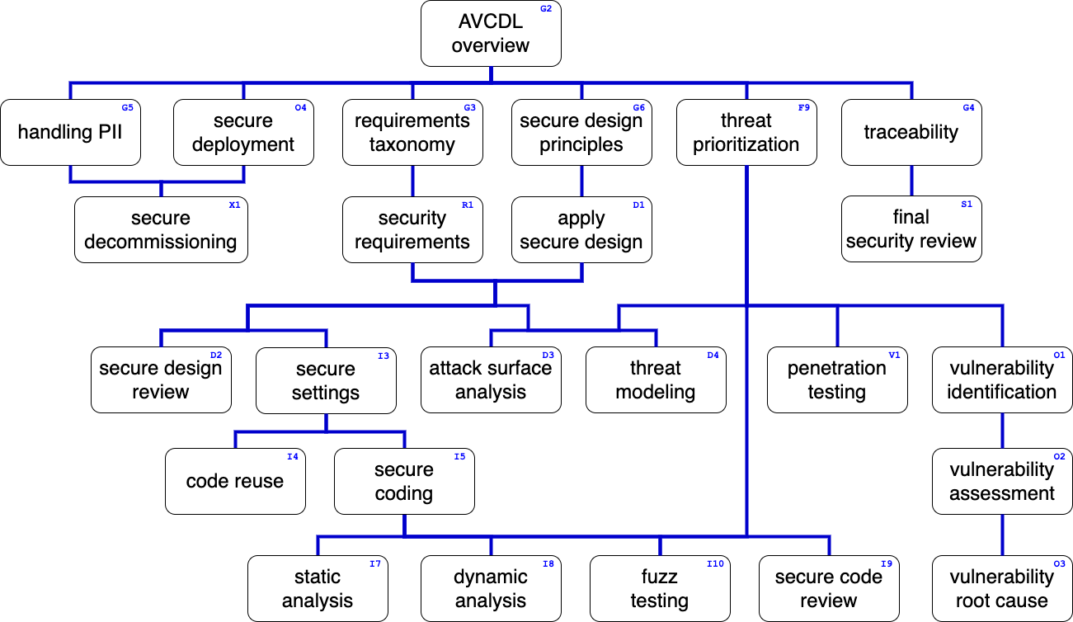
Training Path
Notes:
Script:
This diagram shows the overall AVCDL training path.
If you're taking this training, it's assumed that you've already completed the AVCDL Overview training,
and additionally, that you've completed the
Requirements Taxonomy
Security Requirements
Secure Design Principles
Apply Secure Design
Threat Prioritization
Secure Settings
and
Secure Coding
trainings.
This training will cover an overview of Static Analysis.

Slide 3
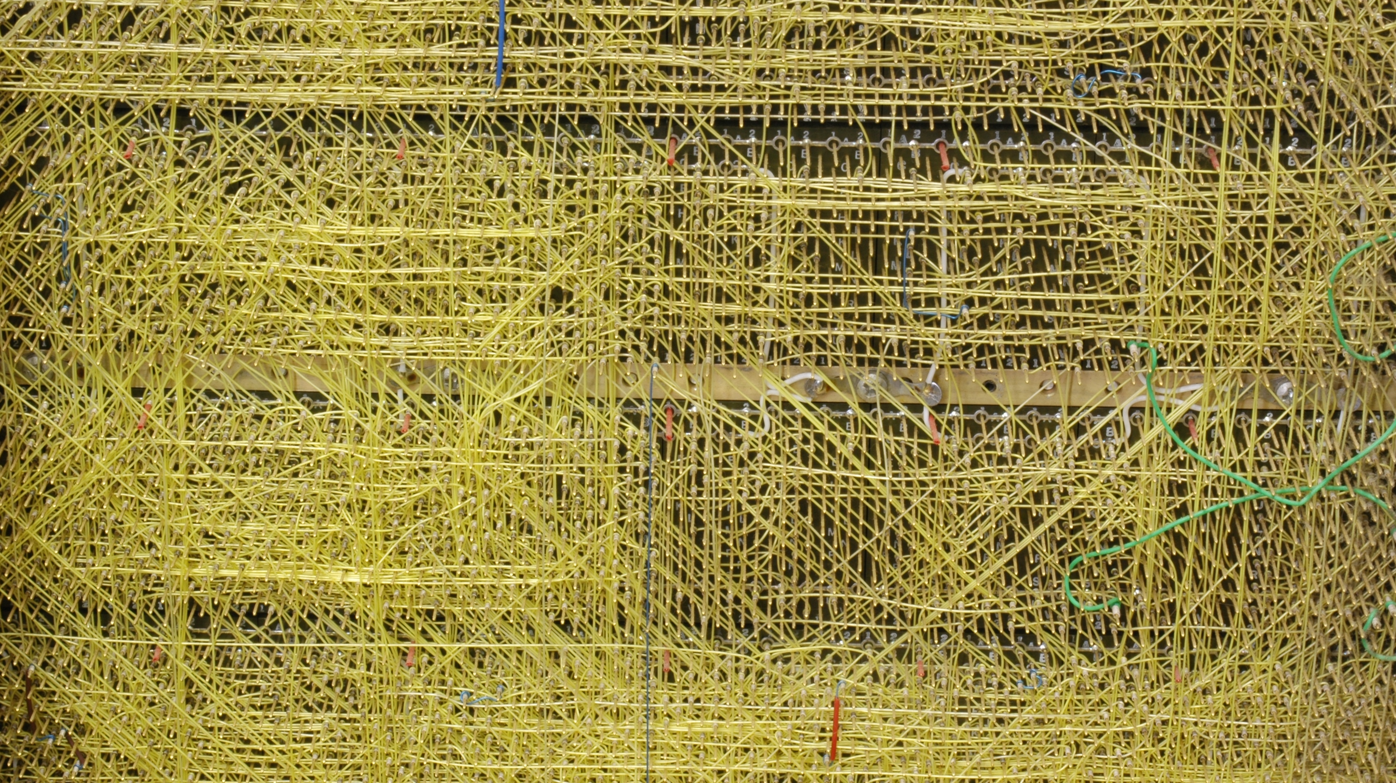
Introduction *
* PDP-8I wire-wrapped backplane (link in references)
Notes:
Script:
Long before hundred million line programs became a thing, a motivation for static analysis existed in hardware, and it's exemplified here.
This is a 1960’s era computer backplane.
If we ever needed a visual metaphor for spaghetti code, this does a good job.
[pause]
We can even see some patches that have been applied.
It's a real mess.
In order to determine what's gone wrong, you have to poke around until you find where the fault is.
Sadly, much of the time, we treat software in the same manner.
It would be a lot easier if we could systematically analyze code and identify issues that typically arise in highly complex systems.
That's where static analysis comes into play.
Using static analysis, we’re able to look at either the entirety of the system or an individual element within the system and reason on it without ever needing to run the code.
No hardware, no test suites, just code.
And we do this in the development phase, because if we look at the research, we find that it’s between a hundred and a thousand times more cost effective to correct an issue in the development phase compared to during verification or once released.

Slide 4
Analysis Mechanism
Notes:
Script:
Now let's look at the mechanism that static analysis uses to accomplish its task.

Slide 5
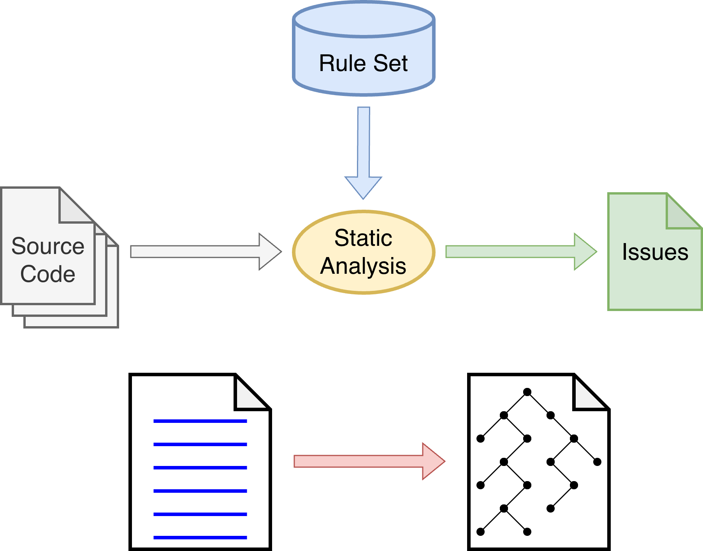
Static Analysis Mechanism
Notes:
Script:
Static Analysis Mechanism
At its most simplistic,
[pause]
a static analysis tool
[pause]
takes source code
[pause]
and identifies issues.
The analysis itself is governed by
[pause]
a rule set.
Because these rules are not restricted to the cybersecurity domain, it's important that the cybersecurity-relevant rules be identified and enabled before a cybersecurity static analysis is performed.
[pause]
There are two approaches taken to perform the static analysis.
[pause]
The first is to use the text of the source itself to do this analysis.
This limits what can be done in terms of both scope and depth of the analysis.
[pause]
The second is to transform the source into a graph and then perform the analysis.
Most commonly, this graph is an acyclic syntax tree.
The advantage is that these graphs can be extended to encompass the totality of the code used to build a system.

Slide 6
Static Analysis Tools
Linters
Compilers
Stand-alone static analyzers
Notes:
Script:
When we talk about static analysis tools, there are three main types that we're going to consider.
[pause]
The first are linters.
These are basically syntax checkers with some added functionality included.
They're the least sophisticated of the tools and have minimal utility from a cybersecurity standpoint.
But if this is all you have, then this is what you’ll use.
[pause]
The next are compilers.
Many people don’t think of a compiler as a static analysis tool, but we're increasingly seeing compilers providing cybersecurity-relevant warnings.
If you use compiled languages, enabling the compiler’s cybersecurity-relevant warnings is going to be the fastest way to get some initial results.
[pause]
The third, and preferred, type of tool is the stand-alone static analyzer.
The advantage here is that they can look across the entire lifetime of variables being passed between the various elements of the system.
Additionally, they typically have a database backing them, allowing them to both look at issues over time, and compare the various interactions between called functions and their callers for consistency.

Slide 7
Workflow
Notes:
Script:
With the background material out of the way, we'll now look at the workflow involved in the static analysis process and then examine each of the activities it contains.

Slide 8
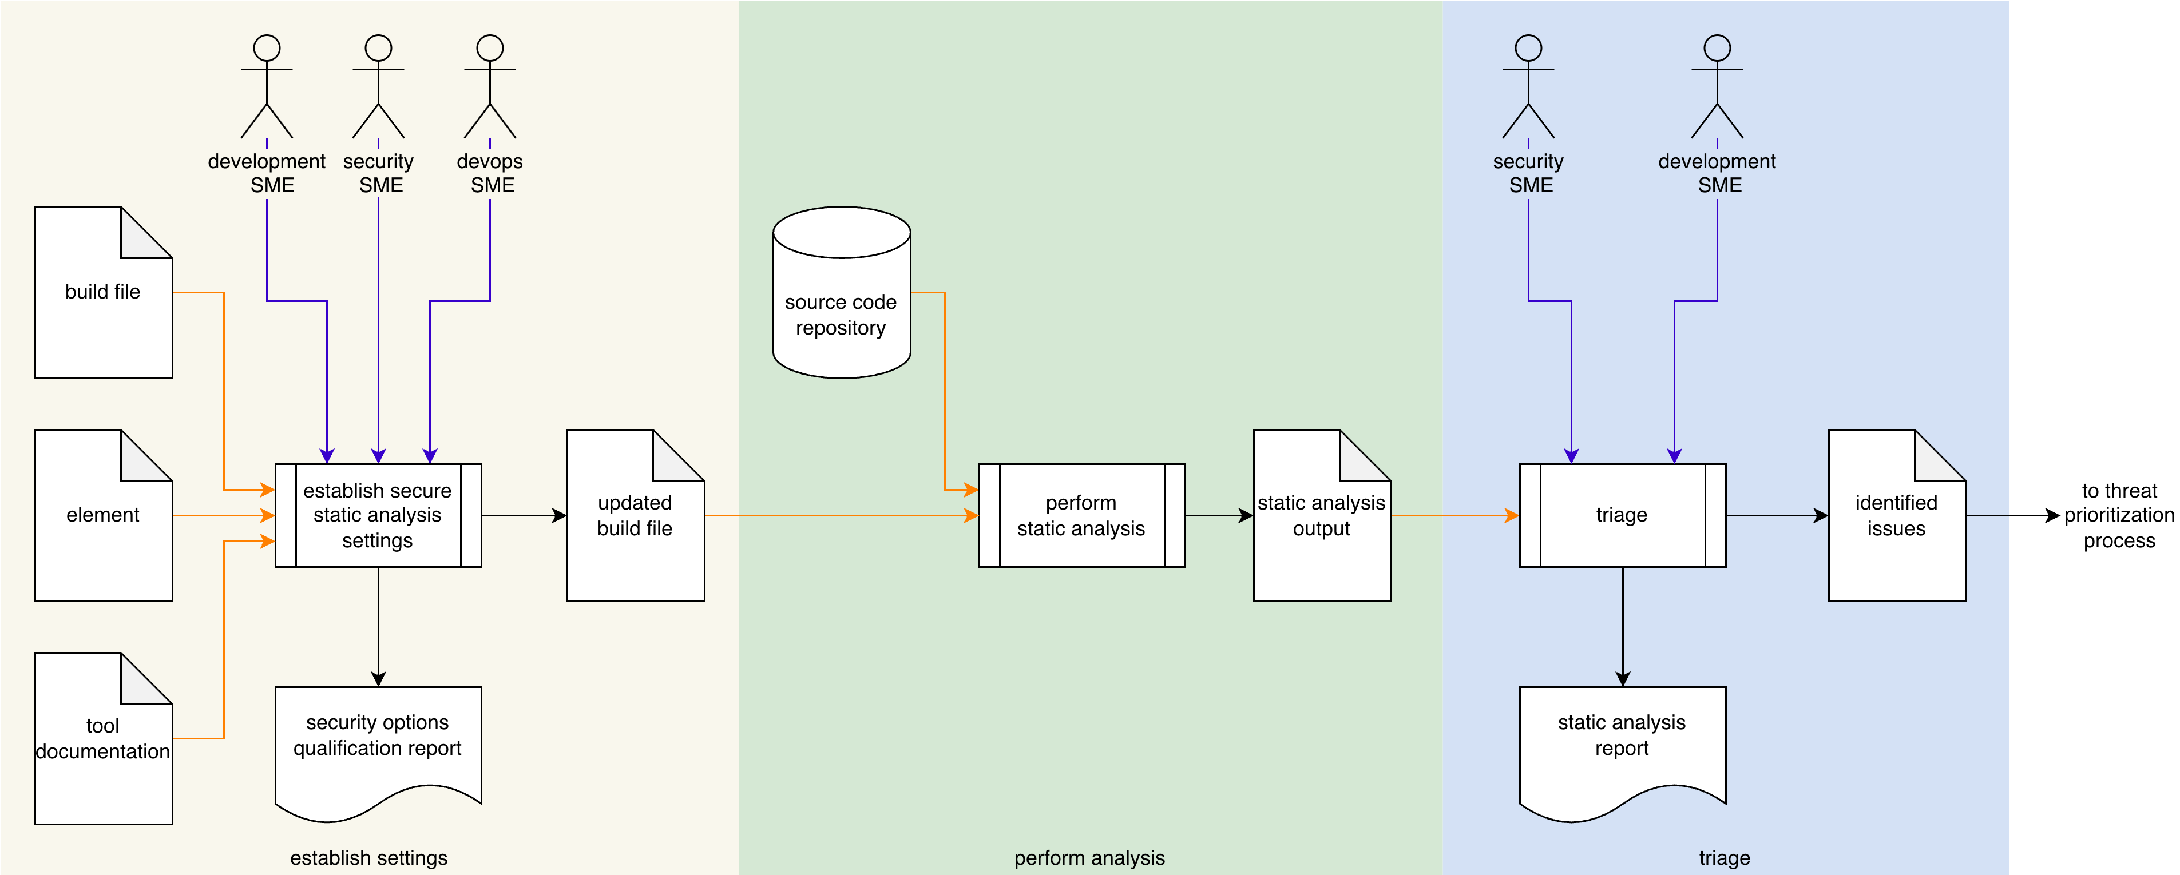
Process Workflow
Notes:
Script:
The workflow for performing the static analysis process is broken down into three discrete activities.
These are:
• establishing the cybersecurity relevant settings
• performing the analysis
and finally
• conducting a triage of the issues identified by the analysis

Slide 9
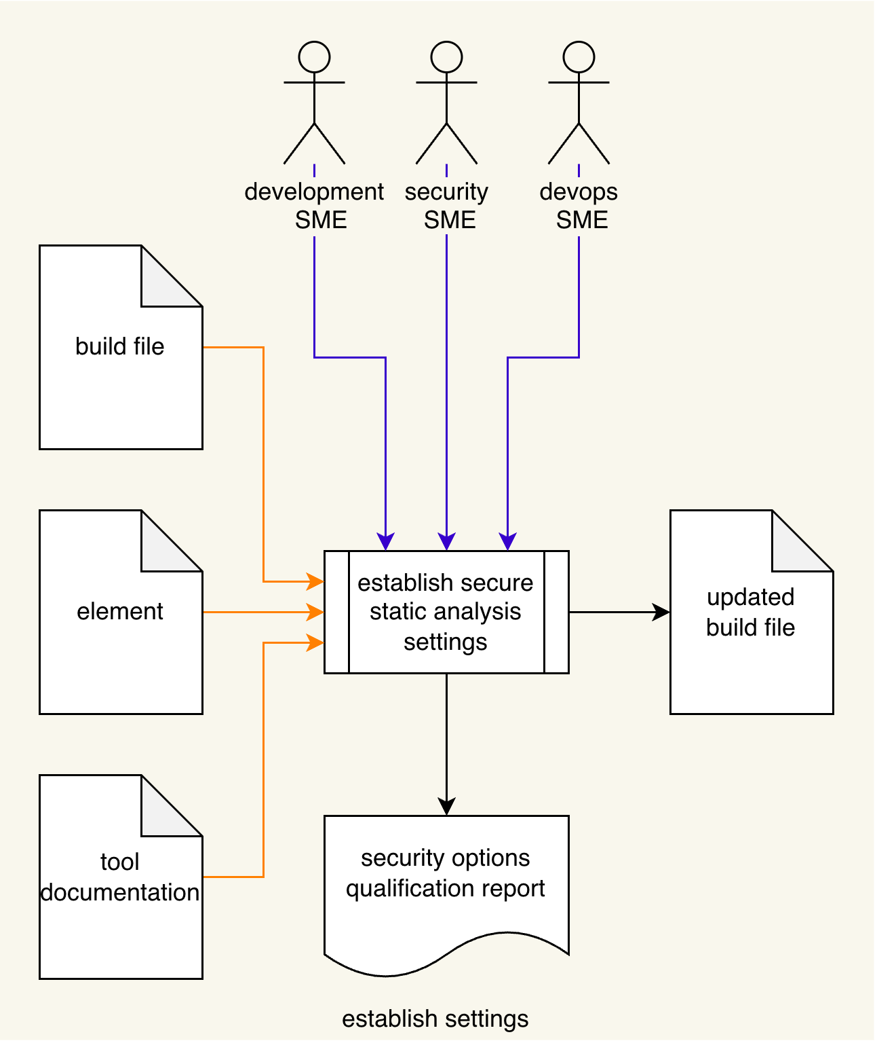
Establish Settings
Notes:
Script:
The workflow for performing the static analysis process is broken down into three discrete activities.
These are:
• establishing the cybersecurity relevant settings
• performing the analysis
and finally
• conducting a triage of the issues identified by the analysis

Slide 10
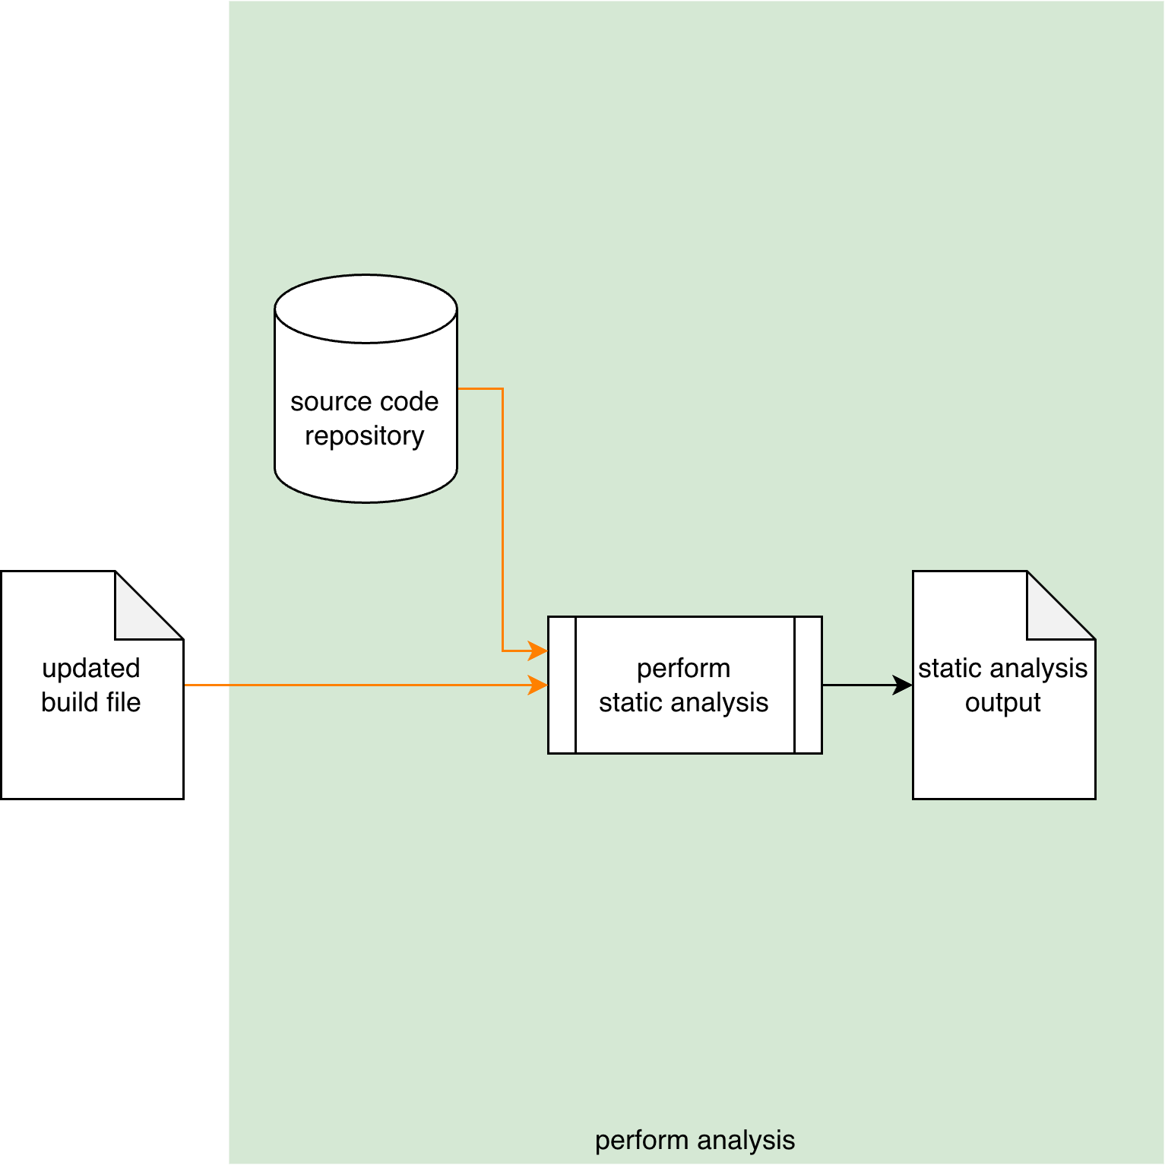
Perform Analysis
Notes:
Script:
The workflow for performing the static analysis process is broken down into three discrete activities.
These are:
• establishing the cybersecurity relevant settings
• performing the analysis
and finally
• conducting a triage of the issues identified by the analysis

Slide 11
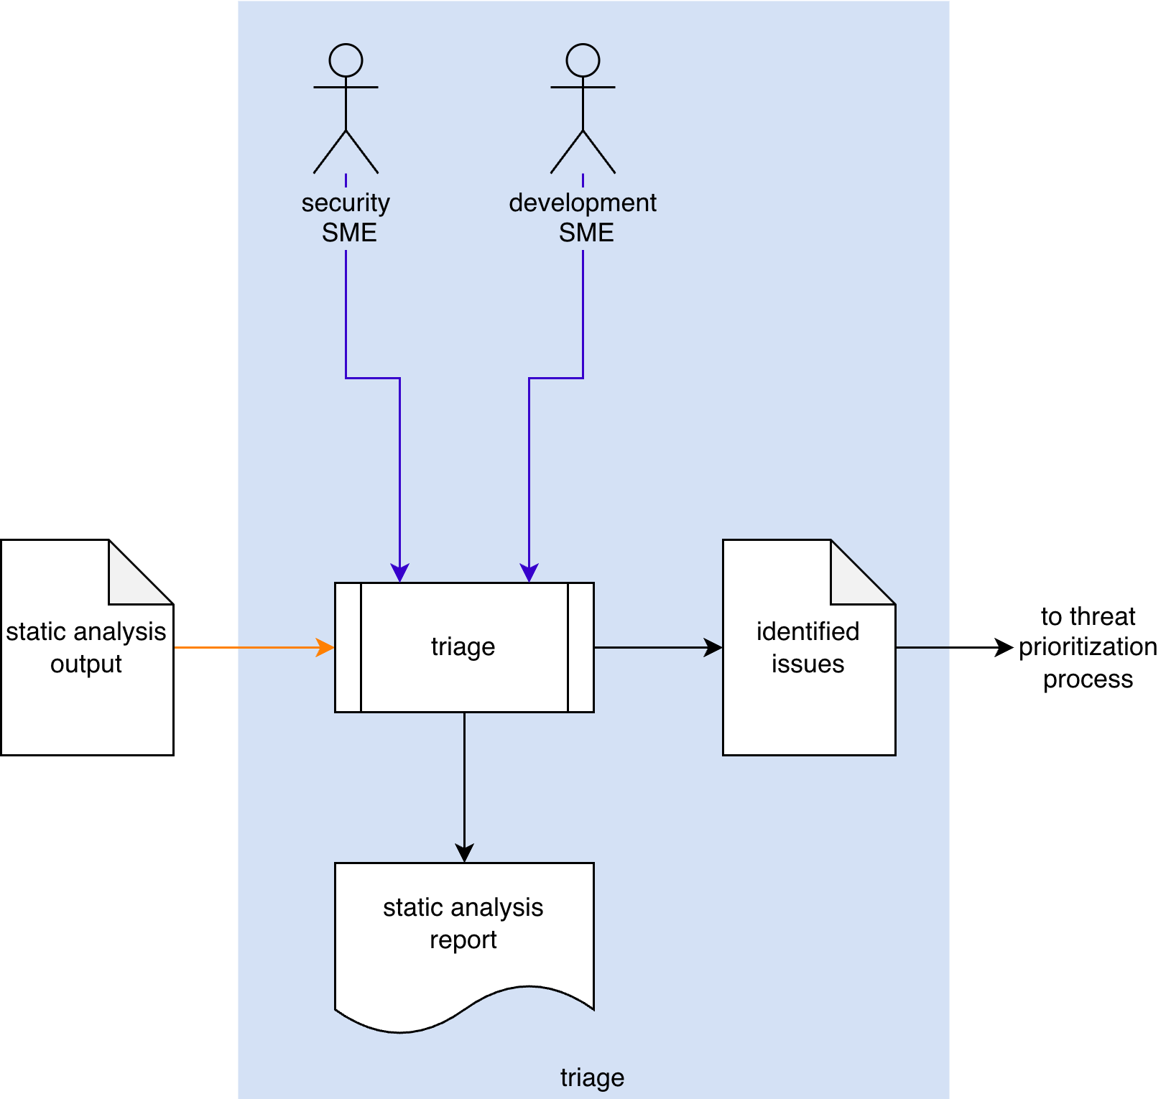
Triage
Notes:
Script:
The workflow for performing the static analysis process is broken down into three discrete activities.
These are:
• establishing the cybersecurity relevant settings
• performing the analysis
and finally
• conducting a triage of the issues identified by the analysis

Slide 12
Activities
Notes:
Script:
Let's now turn our attention to each of the activities that go into the static analysis process.

Slide 13
Establish Settings
Execution time
Notes:
Script:
Our first activity in the static analysis process is that of establishing the settings we'll use.
Now, the activity itself will include a
development SME,
cybersecurity SME
And
devops SME
[pause]
They're going to take the
element
build file
and
documentation
[pause]
and establish a set of settings to be used.
[pause]
These will put into
[pause]
an updated the build file
[pause]
and produce
[pause]
a security options qualifications report.
Now if this diagram seems really information-dense, that's because this is the encapsulation of the secure settings process, and we're not going to cover that here.
[pause]
Because we're impacting the build, it's important to consider the
[pause]
execution time
The reason for this is that since static analysis is part of the test suite to be executed, it may well be time bounded.
And so, it's important to consider how that time bounding will be impacted by the addition of the static analysis task.

Slide 14
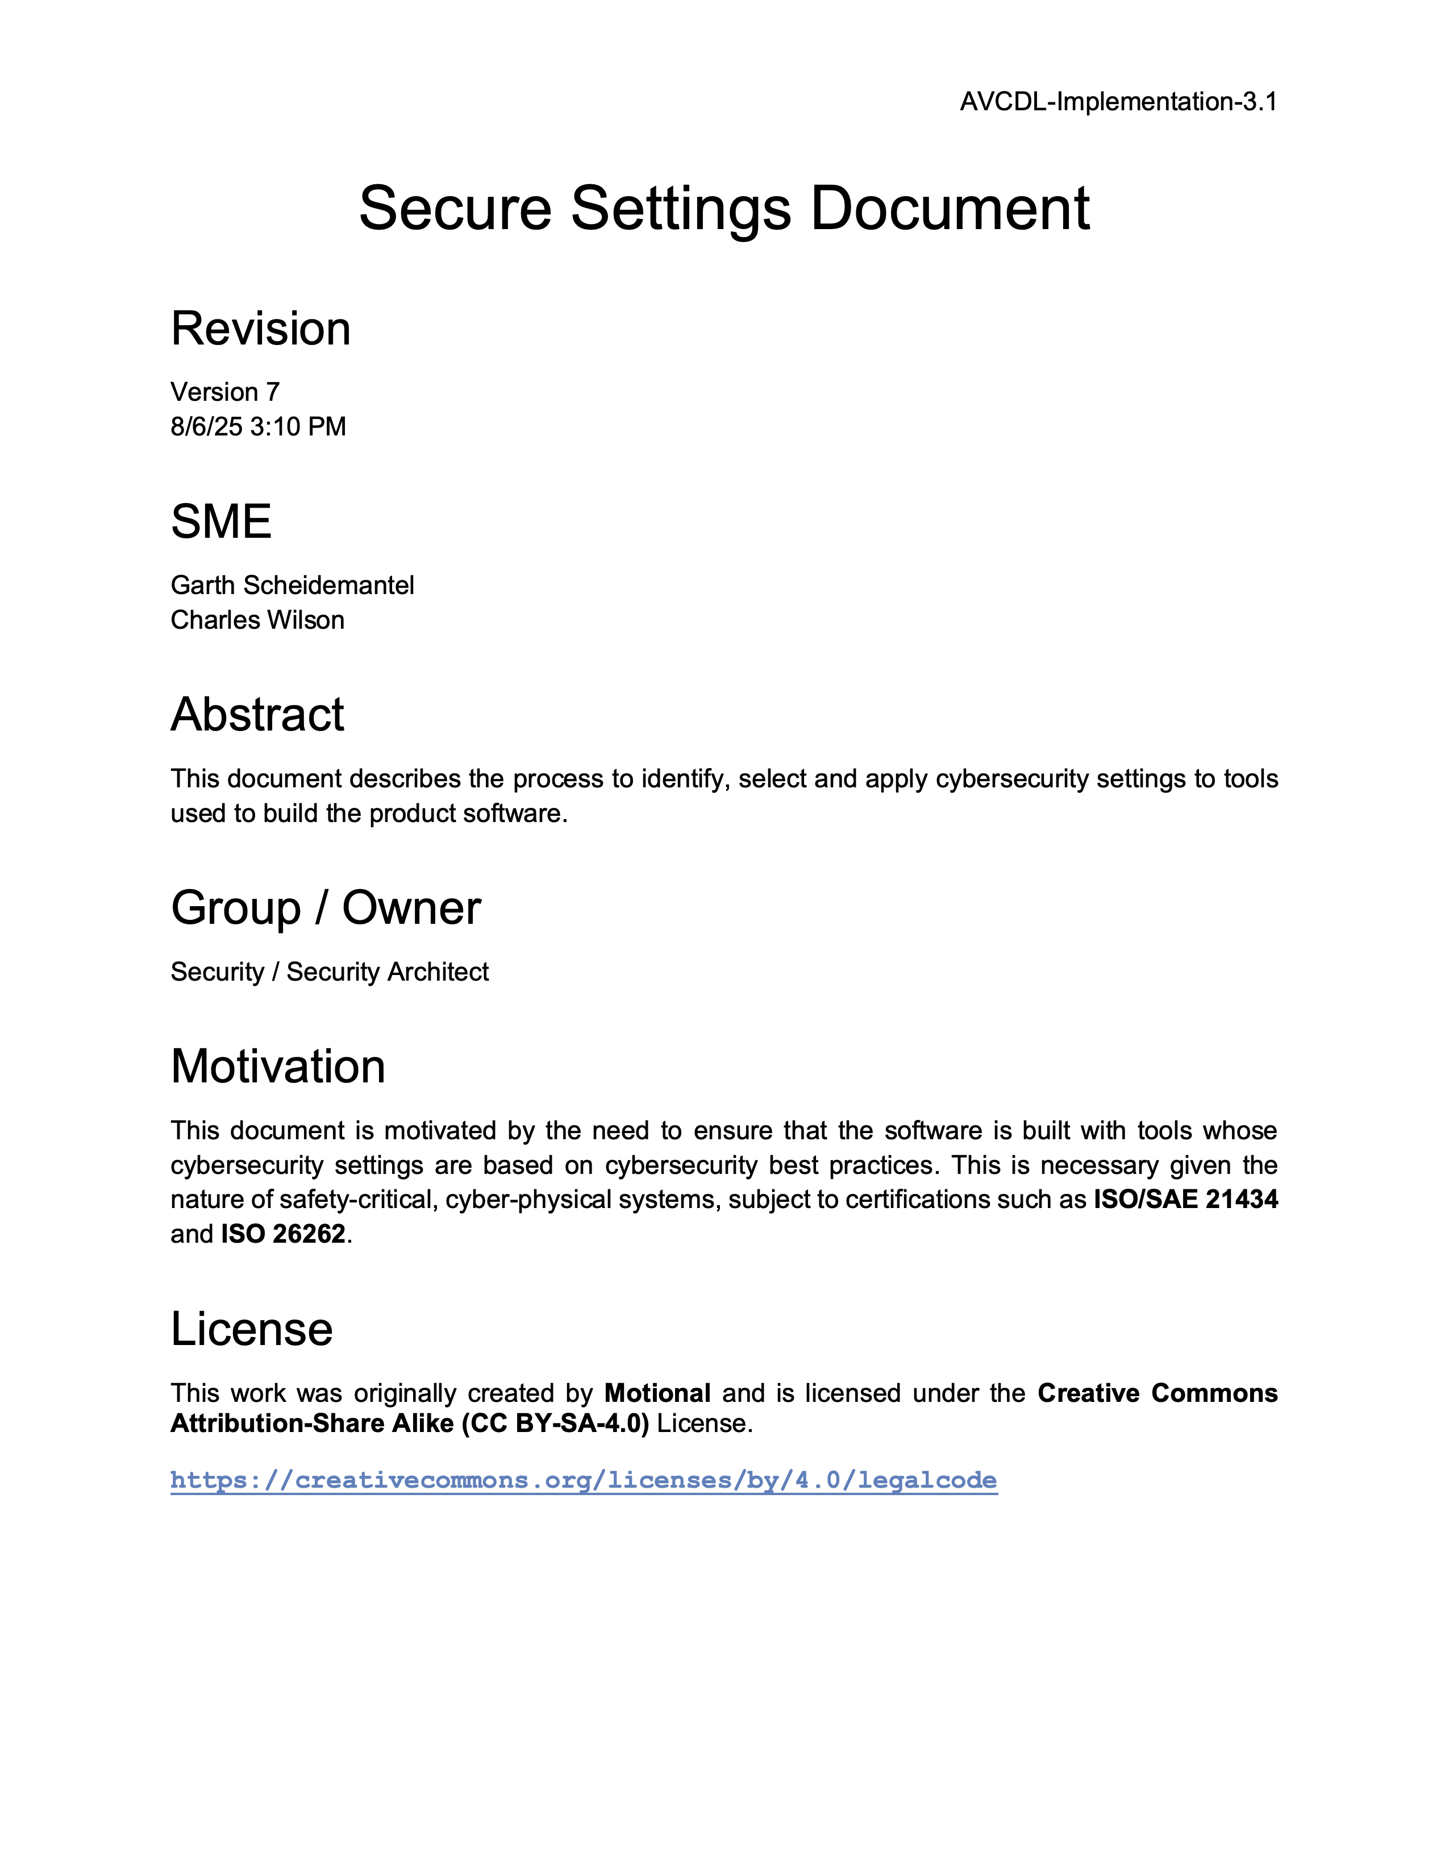
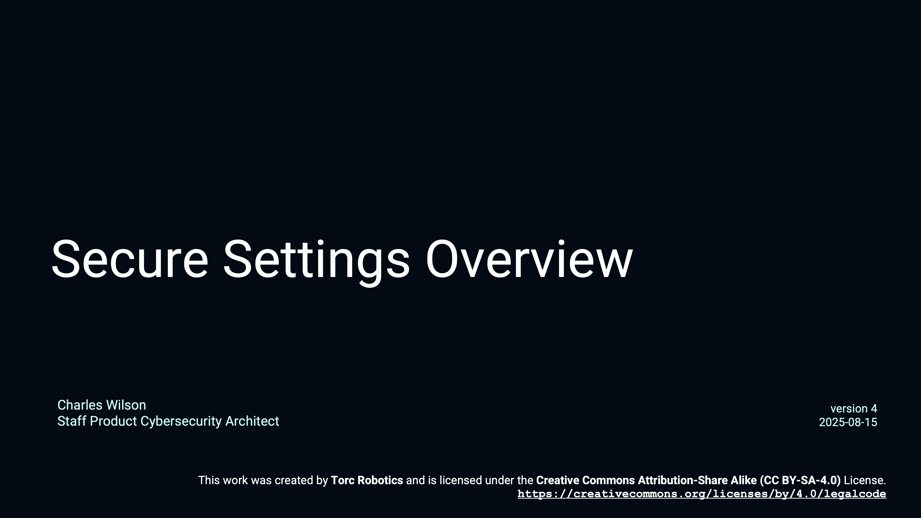
Secure Settings
Notes:
Script:
Rather than rehash a subject that is covered separately, here are some references to review secure settings in more detail.
They are the Secure Settings Overview training video, and the Secure Settings Document, secondary document.
[break]
For a deeper dive, are the materials covering the four activities within the Secure Settings process, you can review the
Identify Options
Categorize Options
Select Options
and
Apply Options
trainings
[break]
and their corresponding tertiary documents.

Slide 15
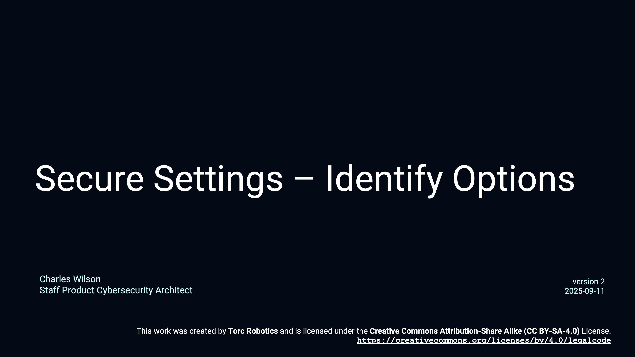
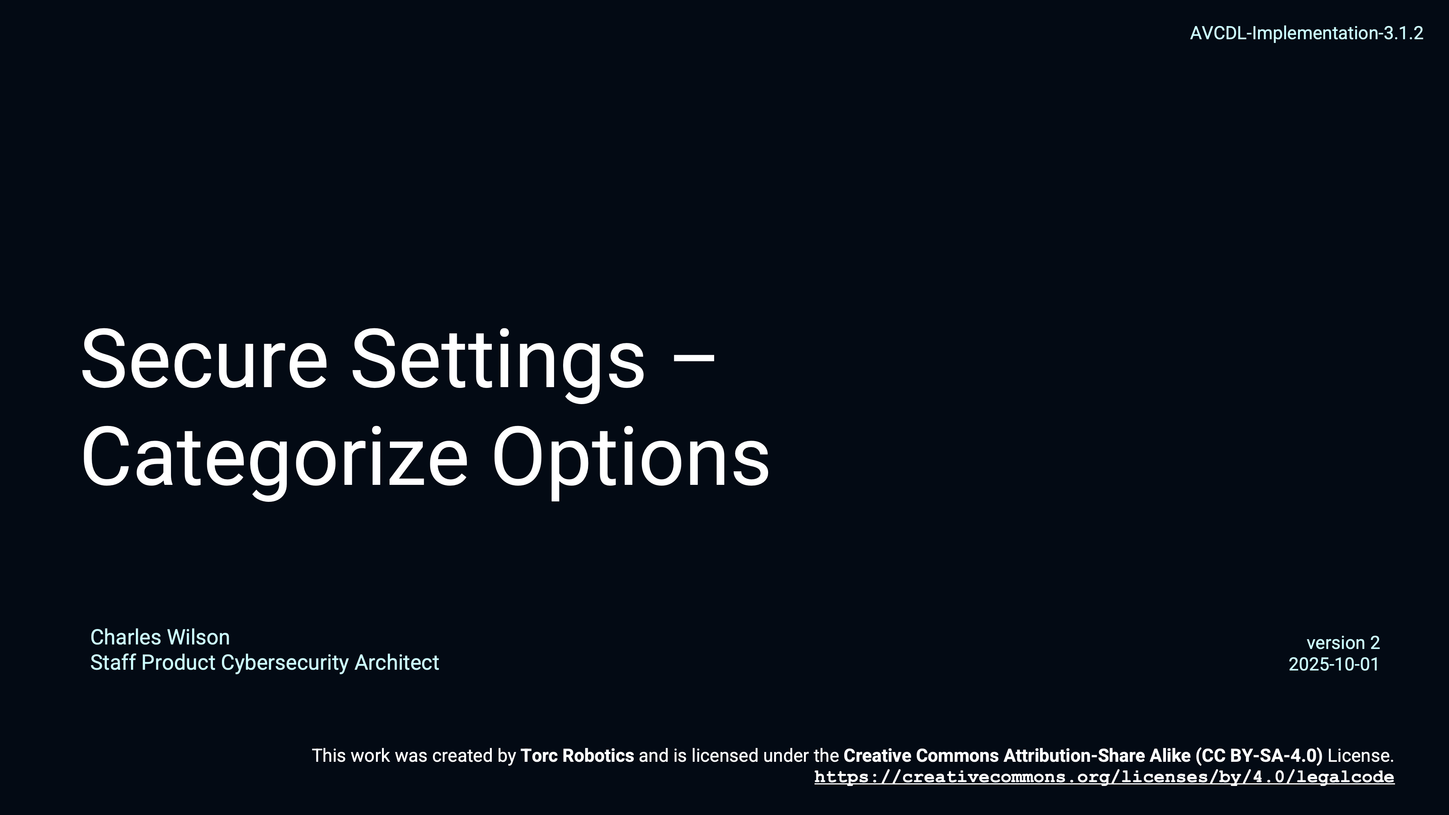
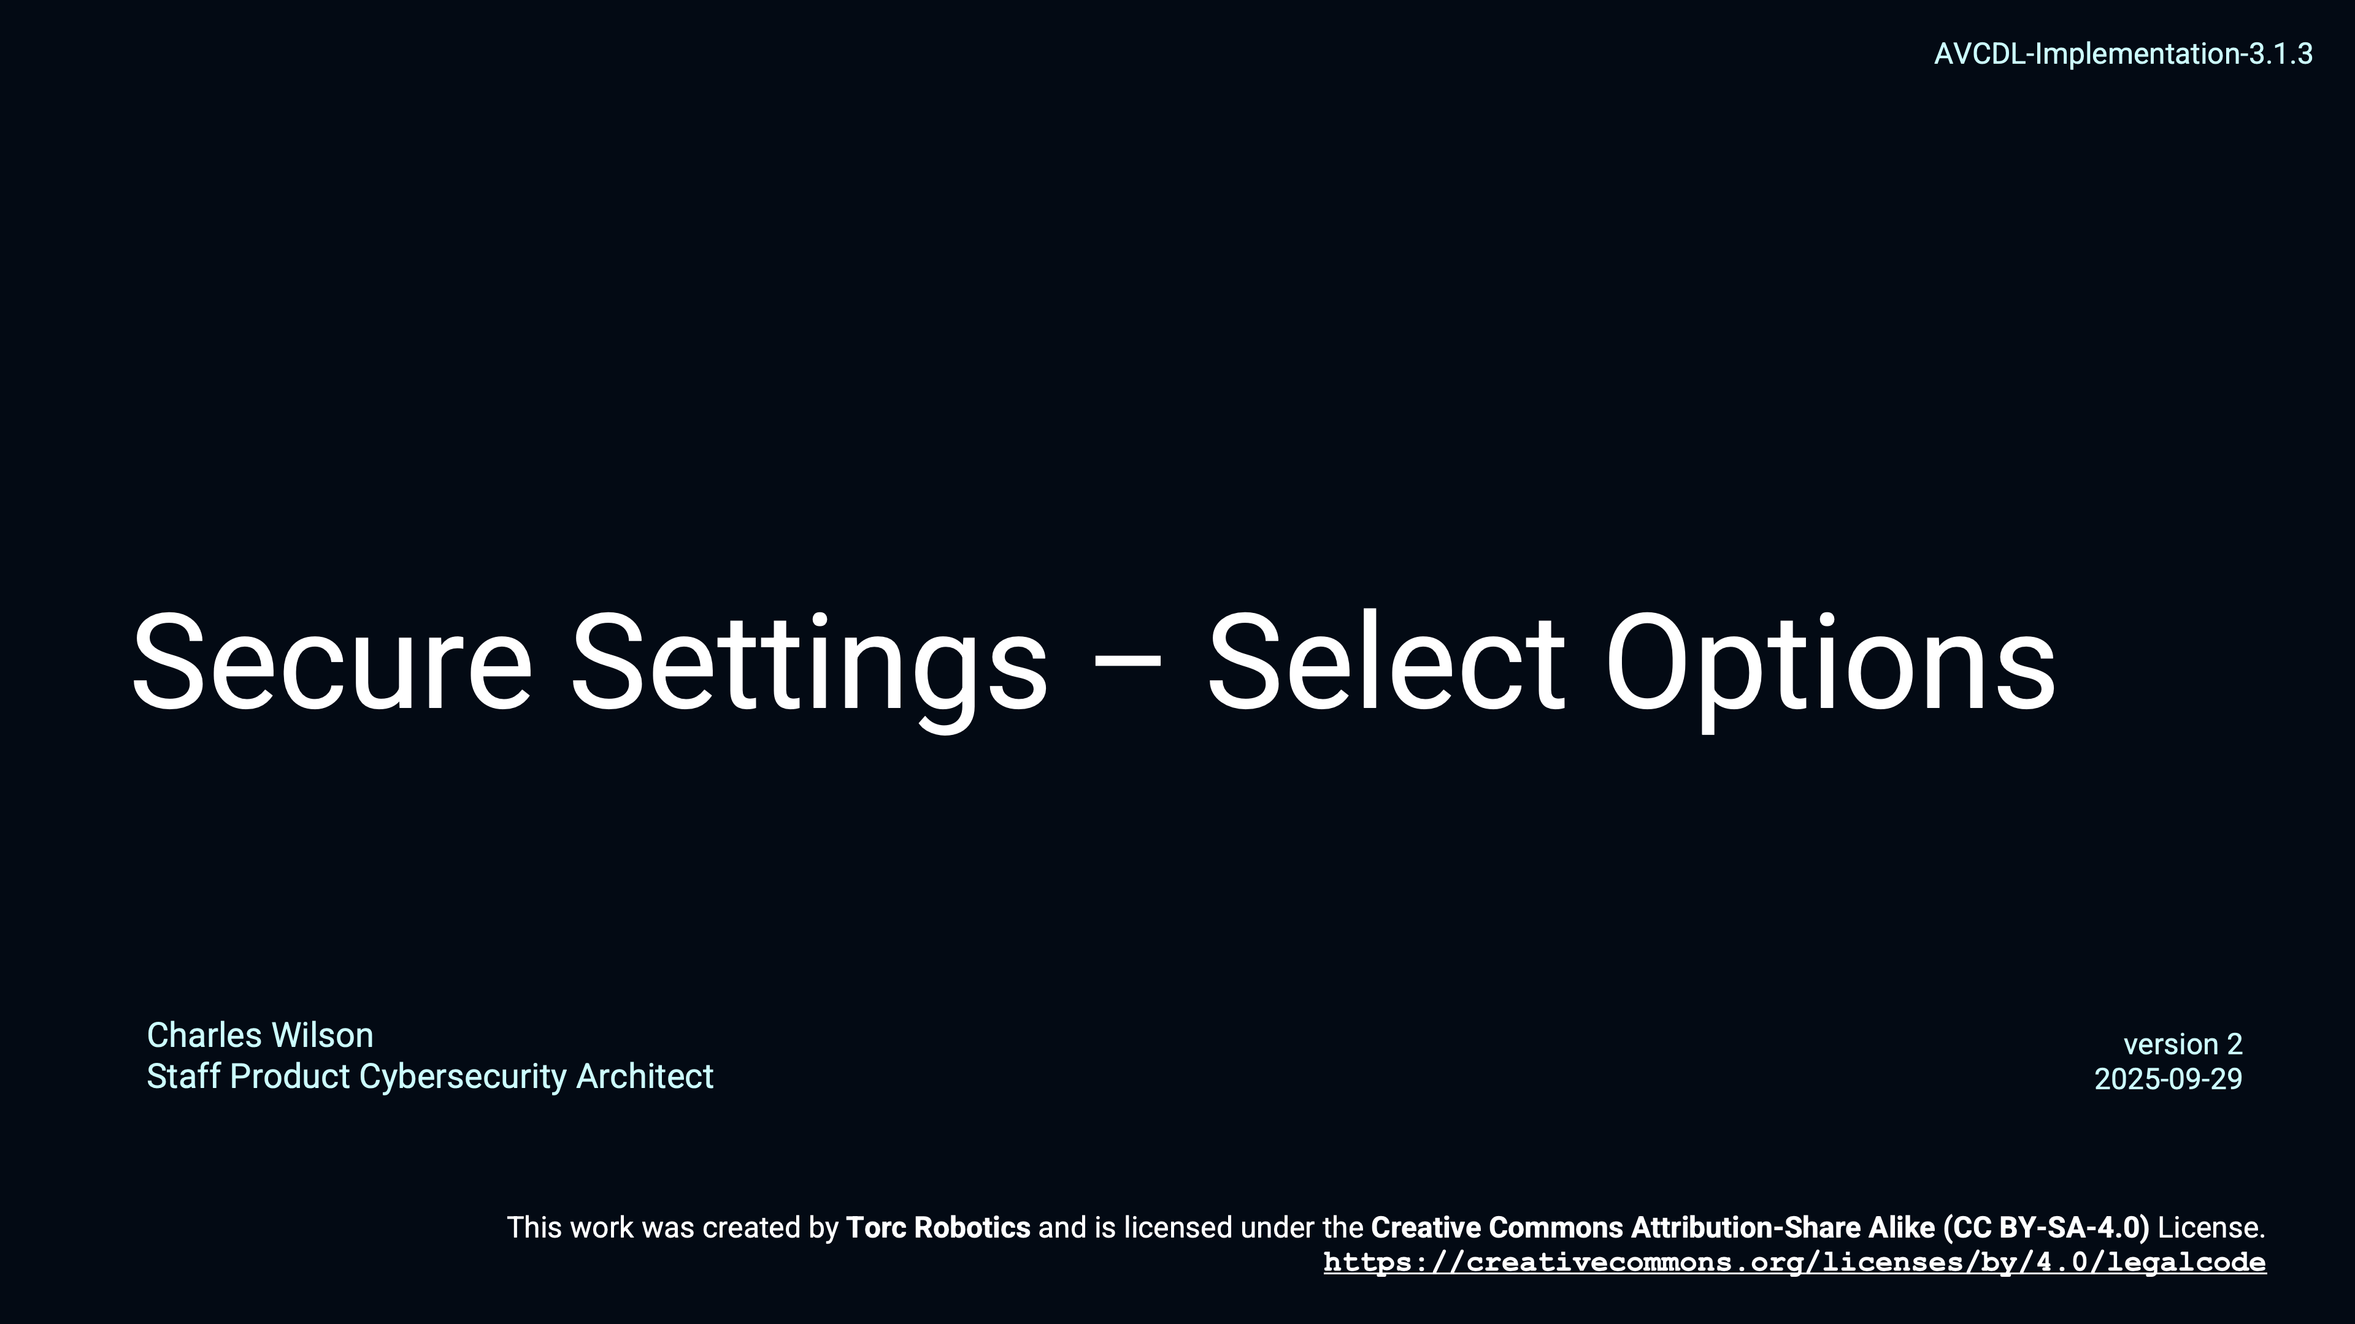
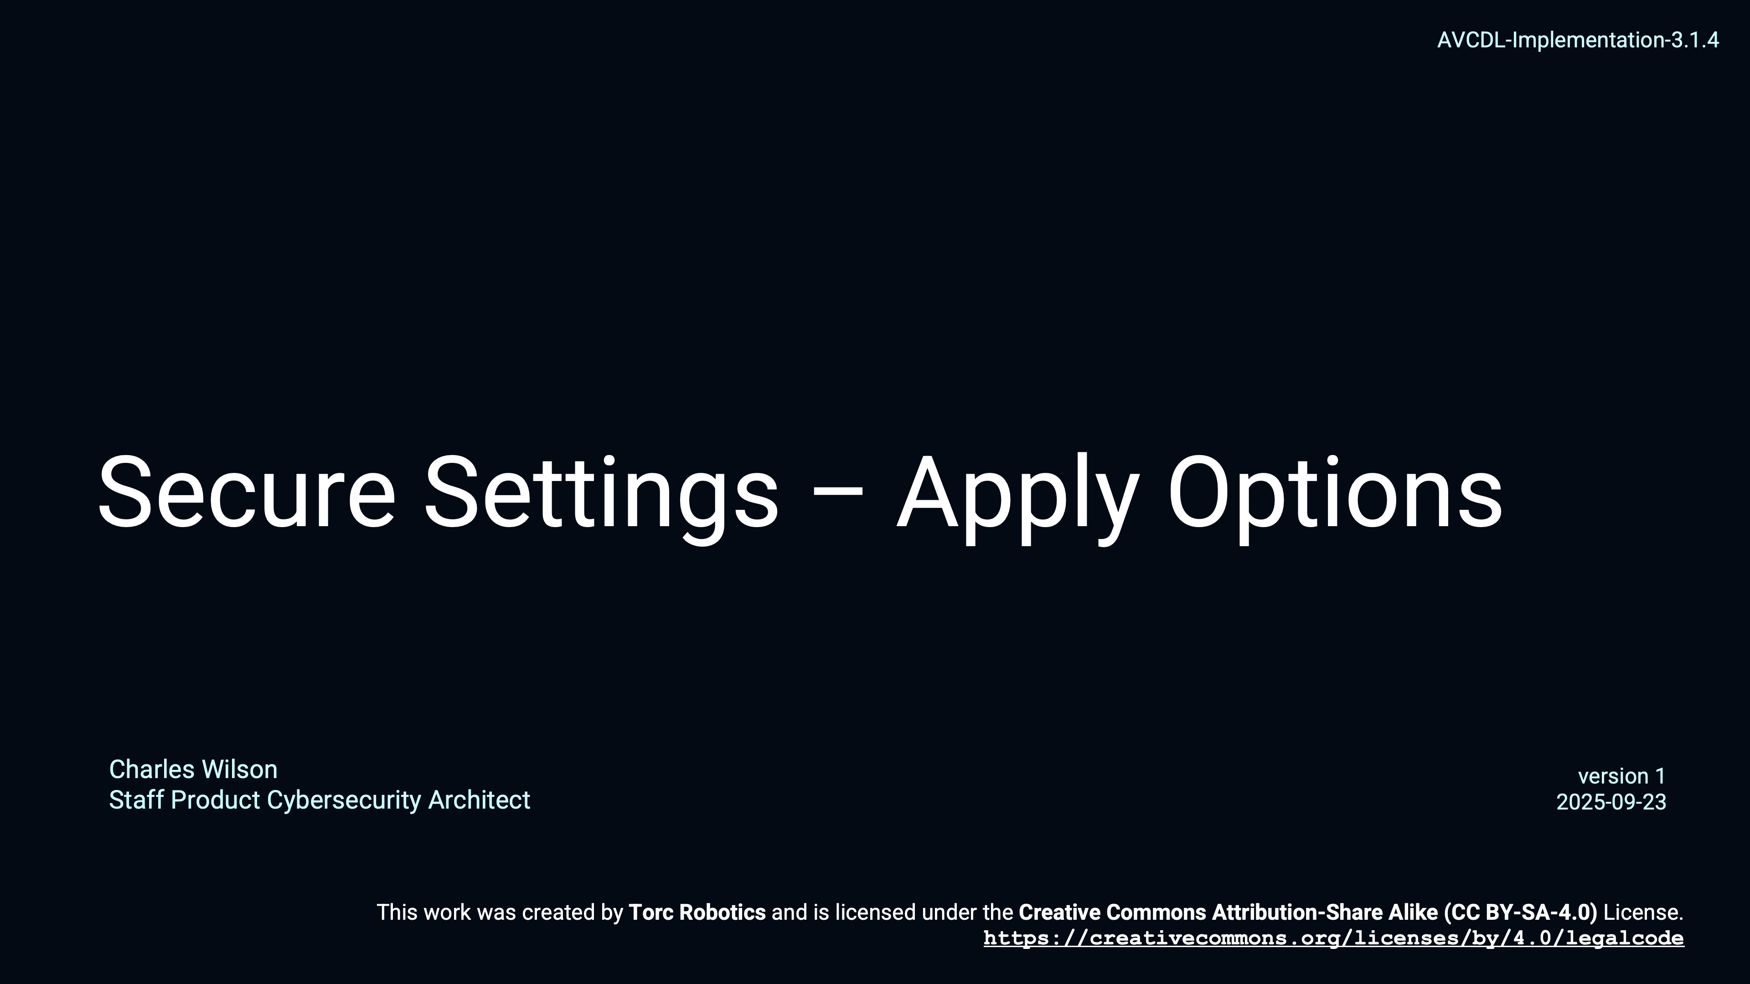
Secure Settings
Notes:
Script:
Rather than rehash a subject that is covered separately, here are some references to review secure settings in more detail.
They are the Secure Settings Overview training video, and the Secure Settings Document, secondary document.
[break]
For a deeper dive, are the materials covering the four activities within the Secure Settings process, you can review the
Identify Options
Categorize Options
Select Options
and
Apply Options
trainings
[break]
and their corresponding tertiary documents.

Slide 16
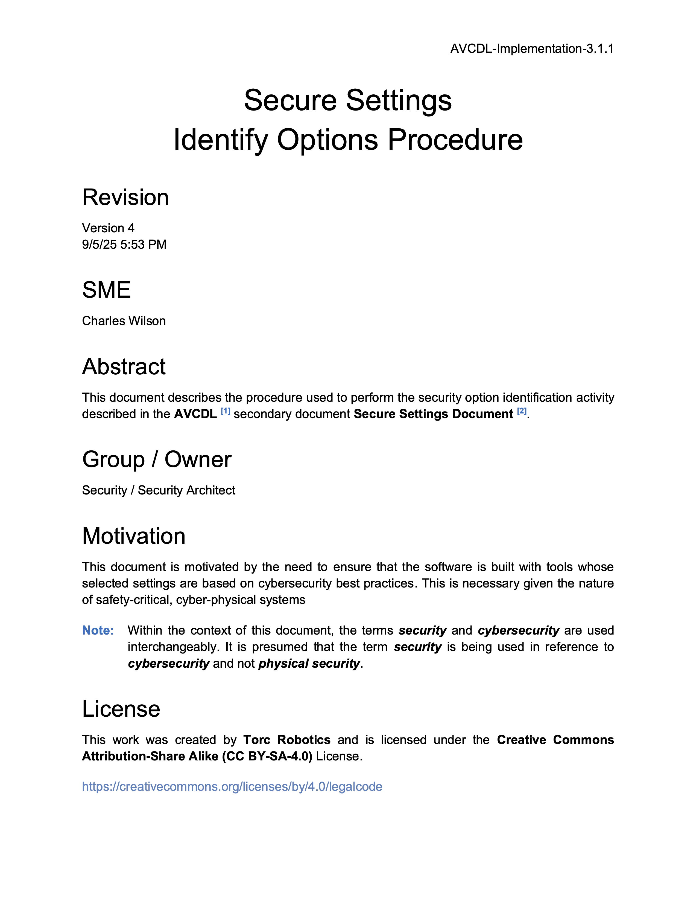
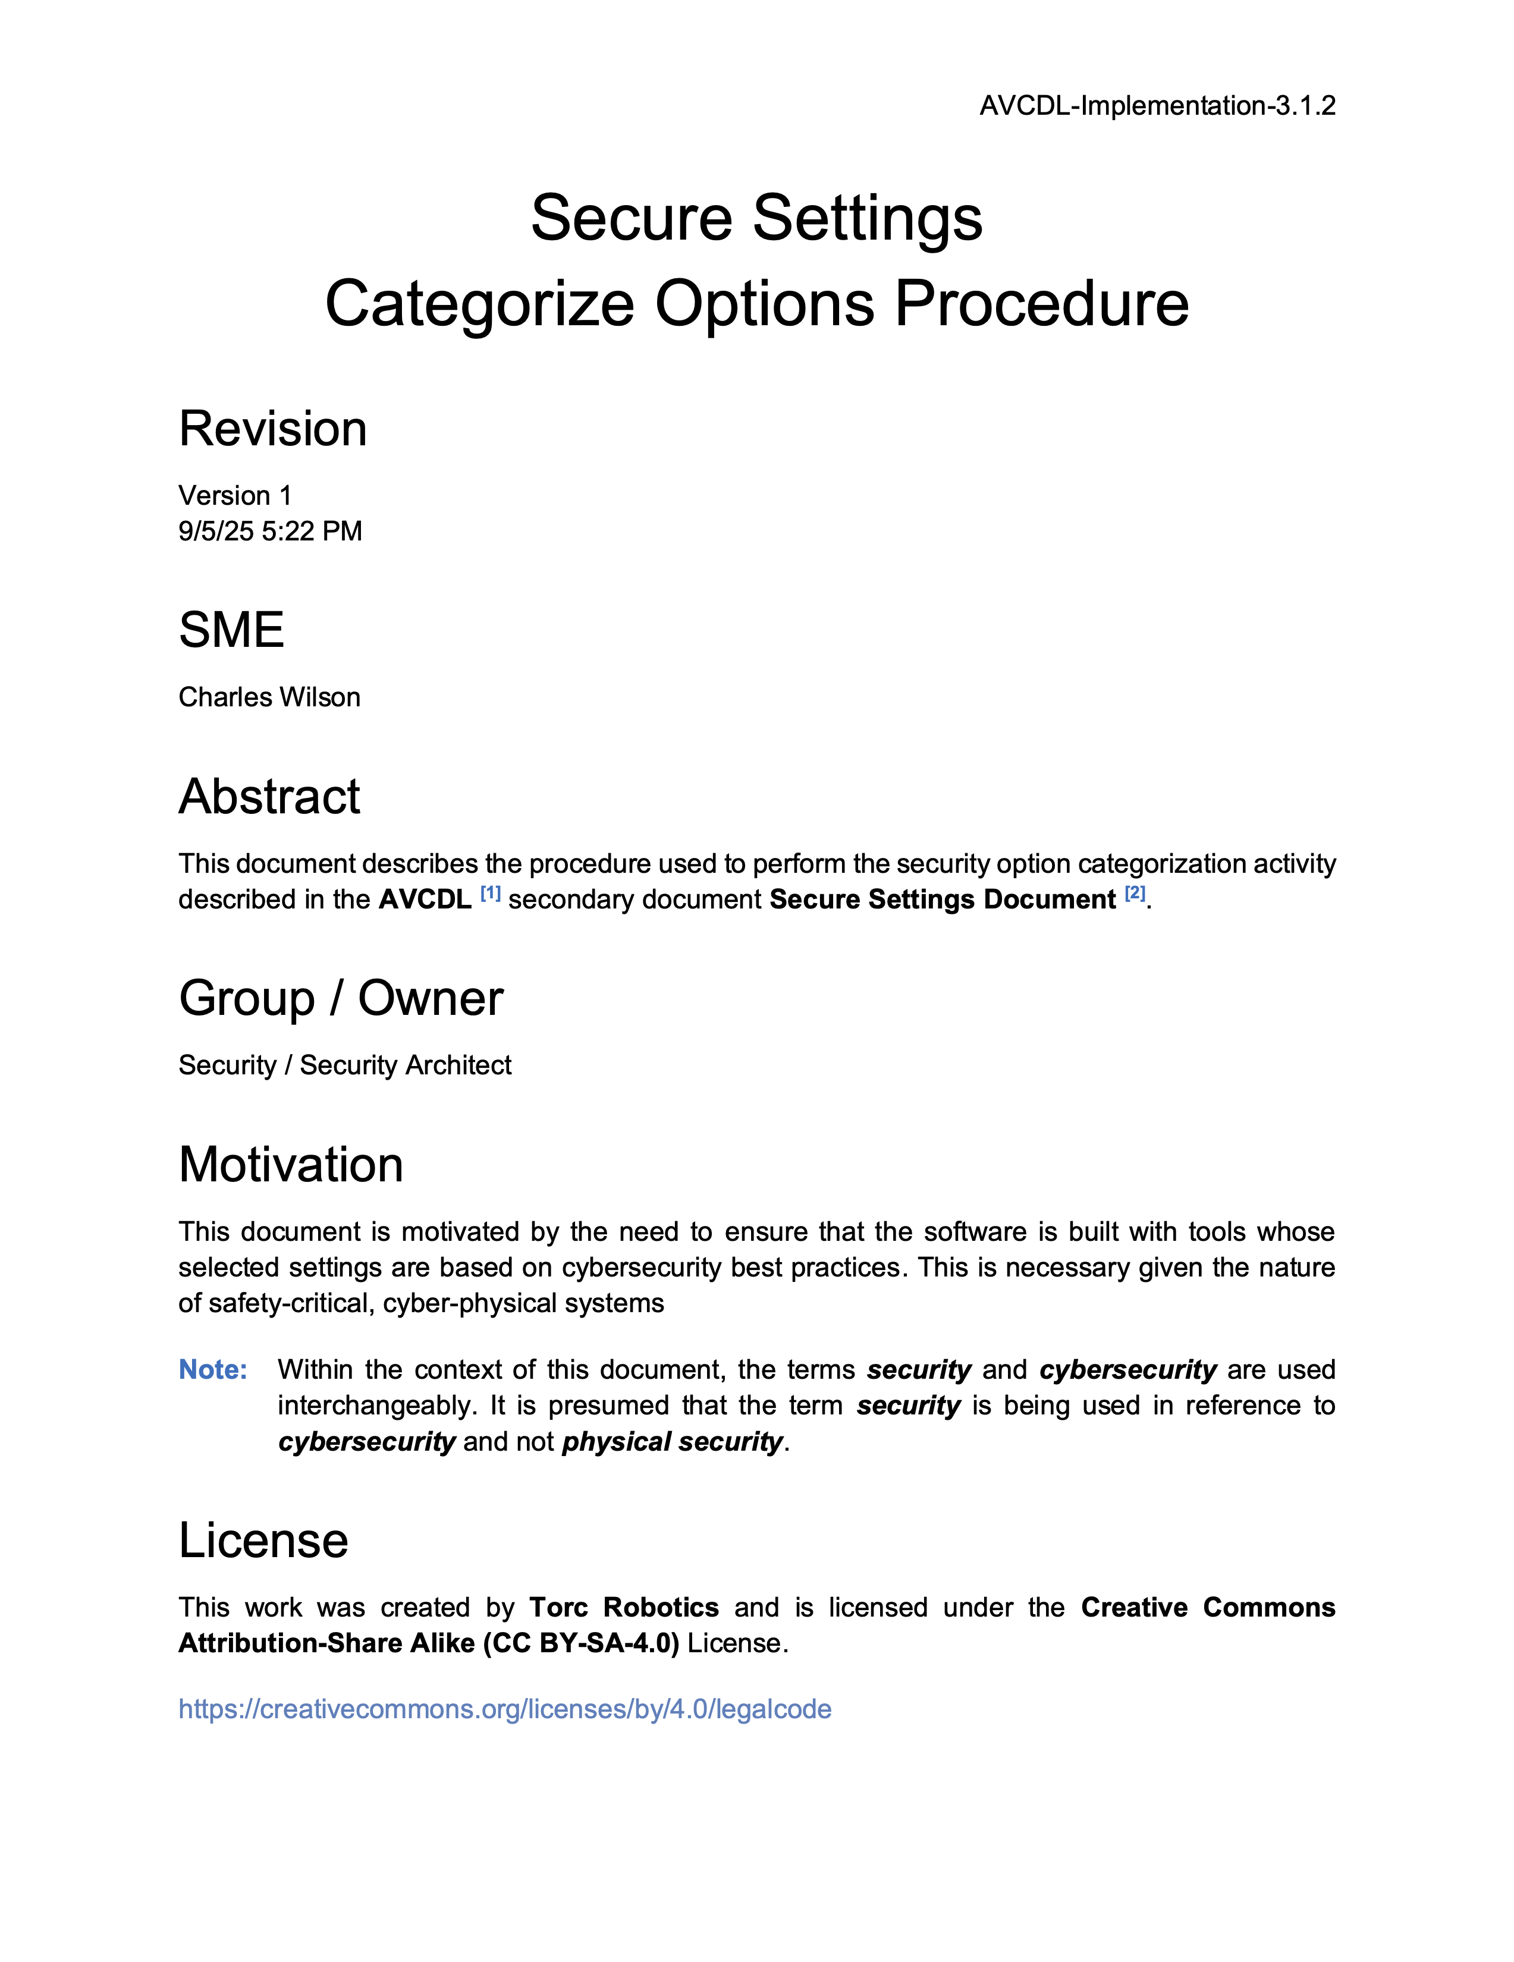
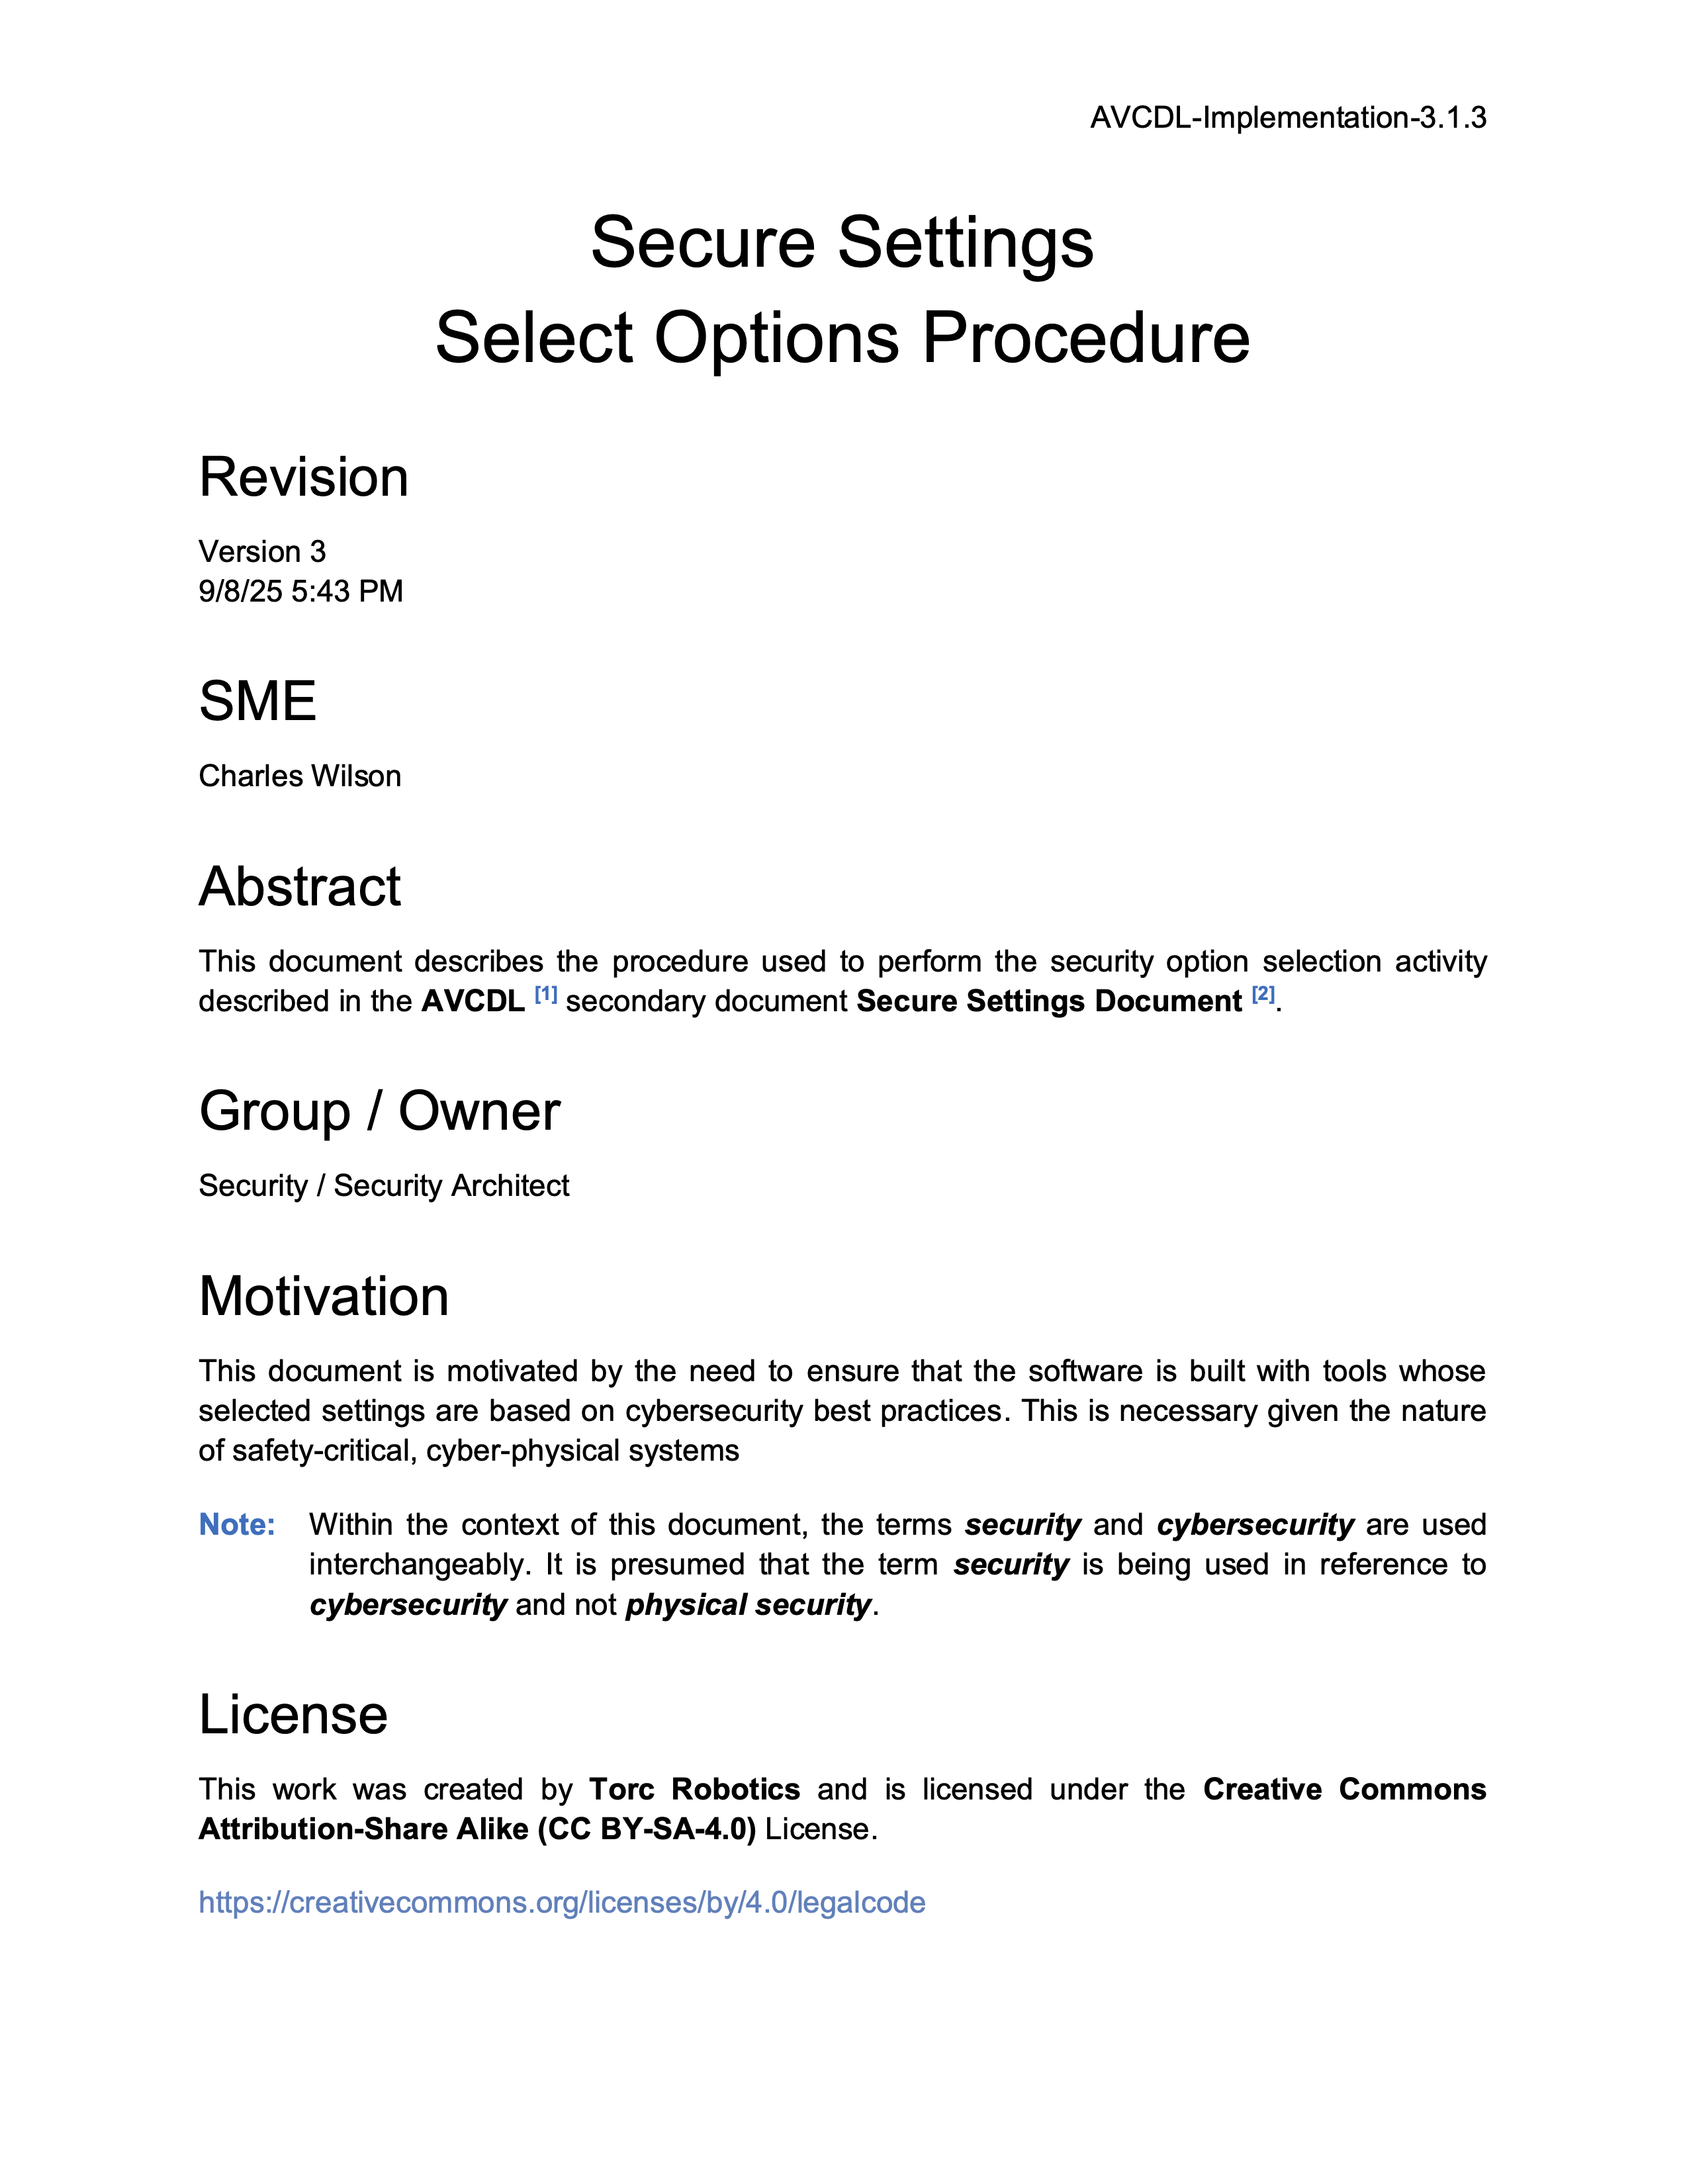

Secure Settings
Notes:
Script:
Rather than rehash a subject that is covered separately, here are some references to review secure settings in more detail.
They are the Secure Settings Overview training video, and the Secure Settings Document, secondary document.
[break]
For a deeper dive, are the materials covering the four activities within the Secure Settings process, you can review the
Identify Options
Categorize Options
Select Options
and
Apply Options
trainings
[break]
and their corresponding tertiary documents.

Slide 17
Perform Analysis
Depth vs Breadth
Timeliness
Notes:
Script:
The second activity in the static analysis process is that of performing the analysis.
[pause]
The build system invokes the static analysis tool with the cybersecurity-relevant settings that we've added to
[pause]
the updated build file.
The static analysis tool then ingests
[pause]
the source code repository and
[pause]
generates output.
[pause]
It’s important to note that although this is a completely automated activity, it may be invoked manually.
[pause]
There are two things that we want to keep in mind here.
The first is whether we're doing
[pause]
a depth-based or a breath-based analysis.
This should be based on the maturity of the development group with respect to cybersecurity-relevant static analysis.
Say you have a hundred thousand lines of code.
It's not unreasonable to have thousands of issues come out of static analysis.
It's important to not have all of the possible options turned on (depth-based) for all of the possible elements that exist within the build (breadth-based).
Approach this with a progressive ramp up of rules to be applied, and likewise start with those elements which are critical, expanding outward.
By the same token, since static analysis looks across lifetimes, it's important to include the elements that bracket the ones of interest in order to get the most accurate results.
The balance of these two approaches will greatly reduce the friction to adoption.
[pause]
The second thing to consider is timeliness.
Although it is possible to perform static analysis on the finished product, this is in all likelihood going to generate a lot of issues, especially if an analysis has not been performed before.
Standing up cybersecurity-relevant static analysis early in the development process is going to be to the benefit of everyone.

Slide 18
Triage
File issues immediately
Tool false positives
Notes:
Script:
The final activity in the static analysis process, as with so many AVCDL processes, is that of triage.
[pause]
The cybersecurity SME and
[pause]
their development SME counterpart will take
[pause]
the static analysis output and
[pause]
triage it.
The issues found to be valid are placed into
[pause]
an identified issues list, which is then sent to
[pause]
the threat prioritization process, and
[pause]
a static analysis report is generated.
[pause]
Some may consider having to put each issue through the threat prioritization process as excessive for issues which are obviously needing correction.
Depending on how the organization implements their processes, it's possible that issues may be entered directly into the issue tracking system instead of passing them through the threat prioritization process when the nature of the issue is unambiguous.
Additionally, if you're performing triage and discover that a tool is reporting an excessive number of false positives, then you should review the settings being used and ensure that they're appropriate.
If necessary, remove those settings which yield incorrect results.
Don't consider settings to be locked down, because at some point those settings may need to change.

Slide 19
Static Analysis Report
tool
element
results
SARIF - Static Analysis Report Interchange Format
Notes:
Script:
When we consider what goes into the identified issues and in fact into the static analysis report by extension, there are three fundamental pieces of information that need to be there.
[pause]
The first is about the tool.
This may seem a bit pointless but consider that there's not going to be just one static analysis report that's ever generated.
There are multiple of them.
And so, as this information is entered into the issue tracking system, and as it goes through the threat prioritization process.
Even as it's read, it's critical to know what tooling is being used.
This extends beyond just its name.
There's a whole host of information needed to identify what was used to perform the analysis.
[pause]
The next thing to consider is the documentation of the element that's been chosen.
You may have gone through the process of deciding what the scope of the analysis is, but as it's conveyed from the process to other individuals, it's important to be documented in a way that allows others to easily locate it.
[pause]
Finally, we need the actual results.
Keep in mind that there may be numerous individual issues related to even a single line of code.
And so, there are going to be lots of results in general.
[pause]
The takeaway here is that we need to ensure that we're including all the information necessary for someone to both replicate and resolve the identified issues.
[pause]
The nice thing is that there is a standard format for representing this type of information.
And a number of tools, including compilers and standalone static analysis tools, have the capability of generating output in this format.
[pause]
The format is SARIF.
[pause]
This is the Static Analysis Report Interchange Format.
SARIF is recommended by the AVCDL not simply for static analysis, but also for other types of systematic analysis.
And a reference to SARIF is included in both the references section and documentation.

Slide 20
Recap
Notes:
Script:
That's an overview of the process used in performing static analysis.
Now let's review what's been covered.

Slide 21
Summary
Establish the settings
Perform the analysis
Triage the results
Start small and expand
Report the findings
Notes:
Script:
As we've seen, the static analysis process is fairly straightforward.
[pause]
For the tool to be used, establish what the cybersecurity-relevant settings are and add them to the build for the element of interest.
[pause]
Perform the analysis, keeping in mind that this is a very time and computationally intensive activity.
[pause]
Triage the results.
Keep in mind that when we're dealing with static analysis, the issue of false positives is unavoidable.
[pause]
Start small and make sure that the settings that were chosen are appropriate.
Expand breadth and depth gradually.
[pause]
Finally, report the findings both in human-readable and machine-readable form.
The latter because we want to automate our processes where possible.
Where feasible use SARIF for the machine-readable representation.

Slide 22
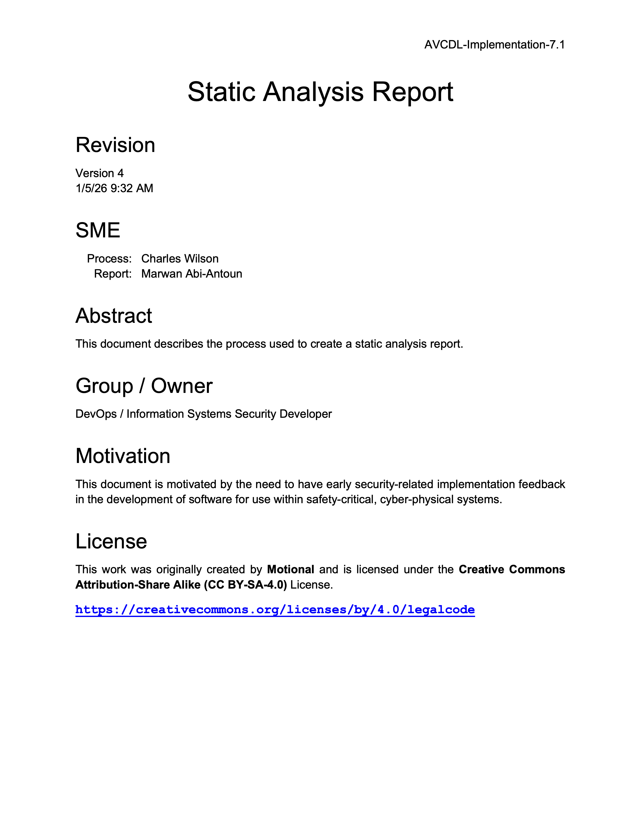
Further Reading
Notes:
Script:
For more information, and to get a more in-depth set of references, the Static Analysis Report secondary document is available in the AVCDL GitHub repository.

Slide 23
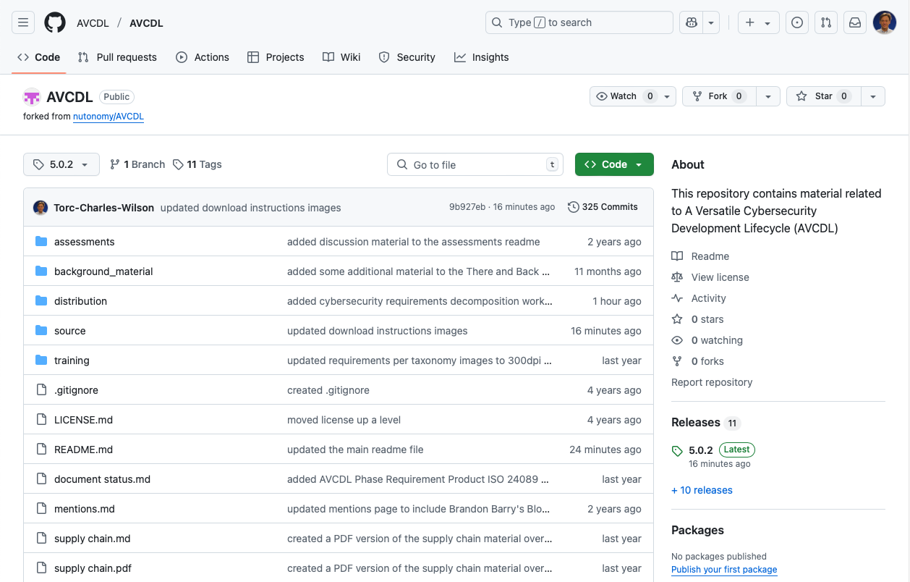
AVCDL on GitHub
https://github.com/AVCDL/AVCDL
Notes:
Script:
All AVCDL materials, both in source and distribution forms, are available on our GitHub site, as shown here.
Because of the size of the repository, it's recommended that you either clone the repository or download a ZIP archive of it, if you're not familiar with using git.
Instructions for downloading a ZIP archive are linked to on the repository’s front page.

Slide 24
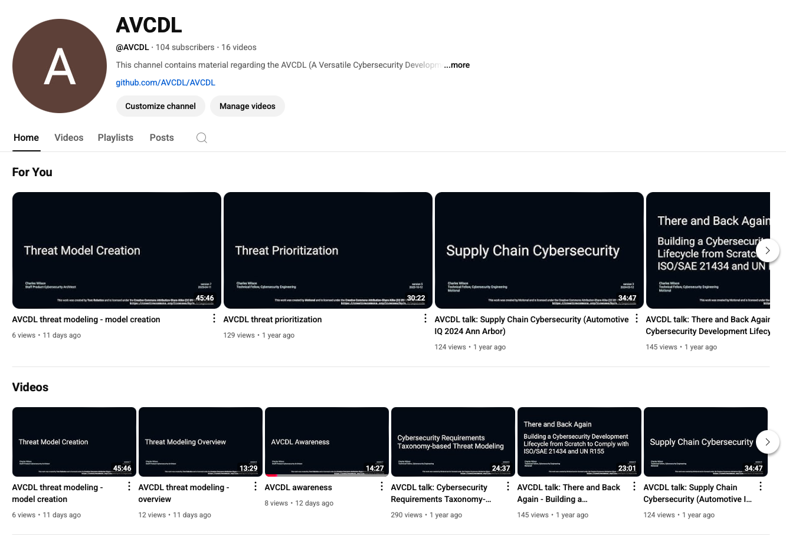
AVCDL on YouTube
https://youtube.com/@AVCDL
Notes:
Script:
Videos covering various aspects of the AVCDL are available on our YouTube channel, as shown here.
It's important to note that all AVCDL materials with the exception of the introductory blog posts are intended for product cybersecurity engineering practitioners.

Slide 25
Next Steps
Notes:
Script:
With this training complete, once you’ve completed the other Static Analysis trainings, you can proceed to the other trainings at this level, these include:
Dynamic Analysis
Fuzz Testing
and
Secure Code Review

Slide 26
References
Secure Settings Document (AVCDL secondary document)
Static Analysis Report (AVCDL secondary document)
Static Analysis Results Interchange Format (SARIF) Version 2.1.0
https://docs.oasis-open.org/sarif/sarif/v2.1.0/os/sarif-v2.1.0-os.pdf
Static Program Analysis
https://en.wikipedia.org/wiki/Static_program_analysis
PDP-8I wire-wrapped backplane (Dave Fischer – CC BY-SA 3.0)
https://commons.wikimedia.org/wiki/File:PDP-8I-backplane.jpg
https://creativecommons.org/licenses/by-sa/3.0/deed.en
How much do bugs cost to fix during each phase of the SDLC?
https://www.synopsys.com/blogs/software-security/cost-to-fix-bugs-during-each-sdlc-phase/
Path to Improve Product Quality, Reliability and Customer Satisfaction
https://ieeexplore.ieee.org/document/497665
Error Cost Escalation Through the Project Life Cycle
https://ntrs.nasa.gov/api/citations/20100036670/downloads/20100036670.pdf
Notes:
Script:
Here are the references to the source material used in the creation of this presentation.
They'll also be included in the video description.
Additionally, this presentation’s source material will be provided on the AVCDL GitHub repository.

